Slide 1
Working With Your Migrated iLearn Courses in Canvas
Canvas Transition Team
San Francisco State University

Slide 2
Types of courses on your Dashboard
With Students
Semester courses- Spring 2023
No Students
Instructor Sandboxes
K16 courses from Fall 2021 – Spring 2022

Slide 3
K16 migrated courses
Courses from Fall 2021 – Summer 2022 were migrated
Migrated courses will have K16 in the name (e.g. ILRN 0101-01-K16-Fall2021)
These are NOT your teaching courses for Spring!
Only this academic year was migrated by the vendor

Slide 4
Manually imported courses
Canvas has a built-in import tool that can handle iLearn backup files
Guide (and video) available at https://athelp.sfsu.edu under the Canvas heading

Slide 5
iLearn items and their Canvas equivalents

Slide 6
Things that import
iLearn content
Where to find them
Sections
Assignments
Choice
Feedback
Files
Folder
Forum
Glossary
Images displayed on the main course page
Modules
Assignments link
Quizzes link
Quizzes link
Files link
Files link
Discussions link
Pages link (glossary entries do not carry over)
Pages or files link, depending on original content

Slide 7
Things that import (continued)
iLearn content
Where to find them
Label
Quizzes
Turnitin Assignments
Section Summary
URL
Wiki
Modules link (converted into text headers)
Quizzes link
Assignments link (as normal assignments)
Pages link
Modules link (as link within a module)
Pages link

Slide 8
Things that do not import using the manual import method
iLearn video
Videos will need to be individually re-linked
Mediasite content
Videos will need to be individually re-linked
Zoom meeting links
Use the built-in Zoom integration instead
Lessons

Slide 9
Post-import checklist

Slide 10
Grades and grade settings
Gradebook in Canvas is very different
Set a grading schema
Set up Assignment Groups for a weighted gradebook

Slide 11
Quizzes
Check your quiz settings to make sure quizzes are graded!
Quizzes may import as “practice quizzes”, which are ungraded
Check your quiz point values to make sure they are what you expect!
Canvas quizzes do not have a separate maximum grade, point value determined by number of points in the questions
Check your open and close dates

Slide 12
Assignments
Check your open and close dates!
Check your submission types!
For iLearn video type assignments, set to online text instead
For Turnitin assignments, set to External Tool and select Turnitin

Slide 13
Course structure and navigation
Sections come over as modules
Treat modules page as a “table of contents”
Modules cannot have much text on the page
Try reorganizing content into Pages instead to provide context

Slide 14
Modules vs Pages

Slide 15
Modules vs Pages
Modules
Add assignments, quizzes, discussions, files, and links using the + button.
Text headers
Indent levels
Pages
Add course links and external links
Colored and bolded/custom text
Pictures
Videos
Documents
Icons
Tables

Slide 16
Publish your course

Slide 17
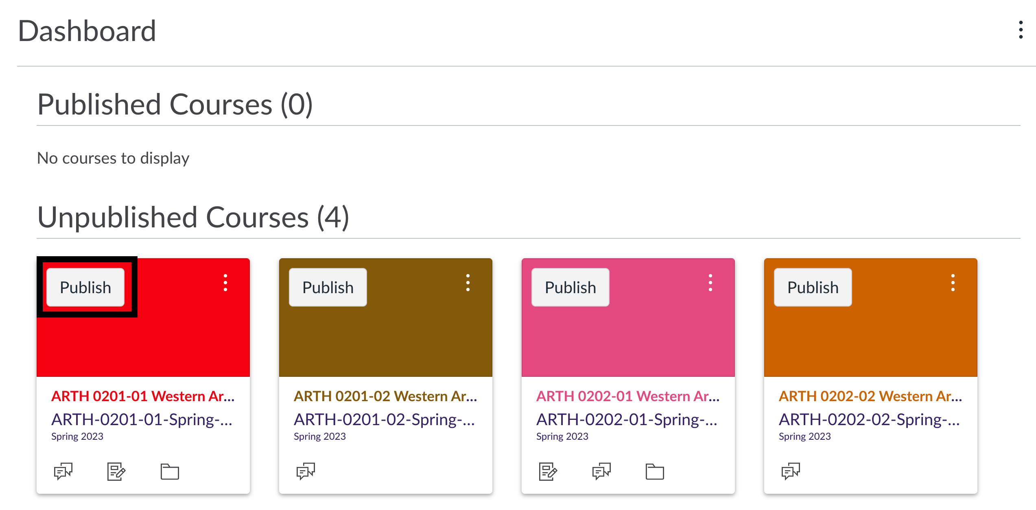
Publish your course
Give students access by publishing your course

Slide 18
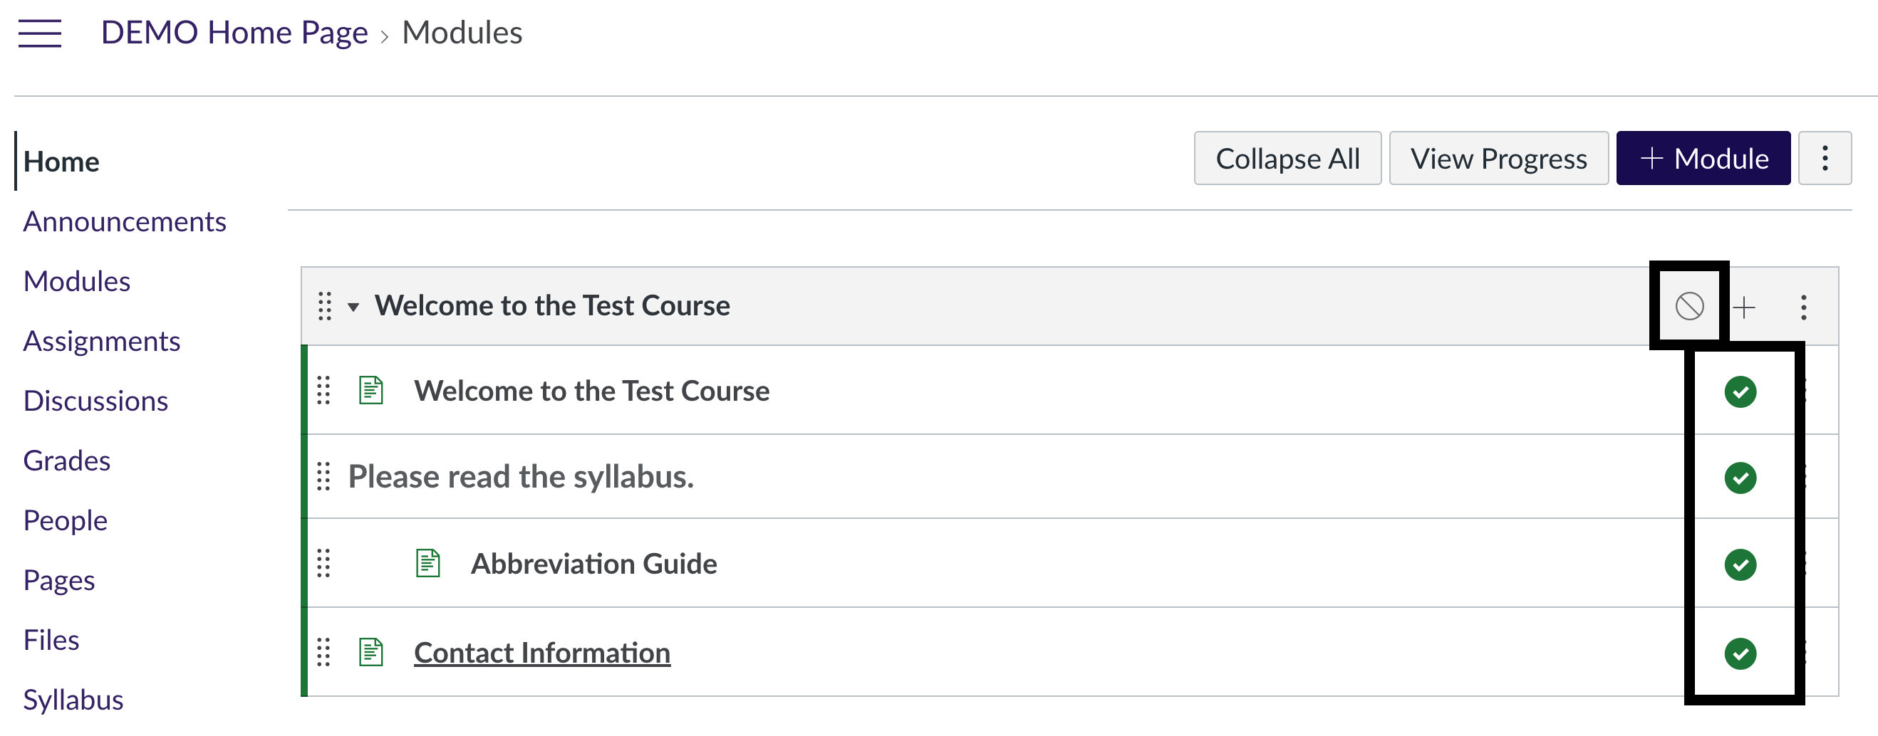
Publish your modules
Publishing your course does not automatically publish everything in your course.

Slide 19
Questions?
Call us: (415)405-5555
Email us: at@sfsu.edu

